Slide 1


Introduction to Gene Prediction
In the field of bioinformatics, gene prediction plays a crucial role in identifying the location and structure of genes within a genome.

Slide 2
Importance of Gene Prediction in Bioinformatics
Understanding Genetic Function
Drug Development
Gene prediction helps in identifying the function and regulation of genes.
Identifying genes assists in understanding diseases and developing targeted therapies.
Evolutionary Studies
Biotechnological Applications
Gene prediction aids in studying genetic variation and evolutionary relationships among species.
It provides insights for genetic engineering and biotechnology applications.

Slide 3
Methods and algorithms used for gene prediction
Sequence Alignment
Gene Finding Programs
Comparative Genomics
Machine Learning Techniques
Uses biological sequences to identify conserved regions and potential genes.
Predicts the location of genes in a genome using statistical models.
Compares genomes of different species to identify functional elements and genes.
Utilizes various ML algorithms to predict genes based on data patterns.
Common algorithms: BLAST, FASTA, Smith-Waterman.
Common programs: GeneMark, Glimmer, Augustus.
Approaches include SVM, Hidden Markov Models, and Neural Networks.
Tools used: Ensembl, UCSC Genome Browser, VISTA.

Slide 4

Challenges in Gene Prediction
Inaccurate gene prediction due to non-coding regions and overlapping genes.
Variability in gene sequence composition presents challenges for accurate prediction algorithms.
Identification of pseudogenes and alternative splicing adds complexity to gene prediction processes.

Slide 5

Evaluation and validation of gene prediction results
1
Comparative Analysis
Compare predicted gene sequences with known gene sequences.
2
Functional Annotation
Assess the function of predicted genes using bioinformatics tools.
3
Experimental Validation
Perform laboratory experiments to verify the predicted gene sequences.

Slide 6

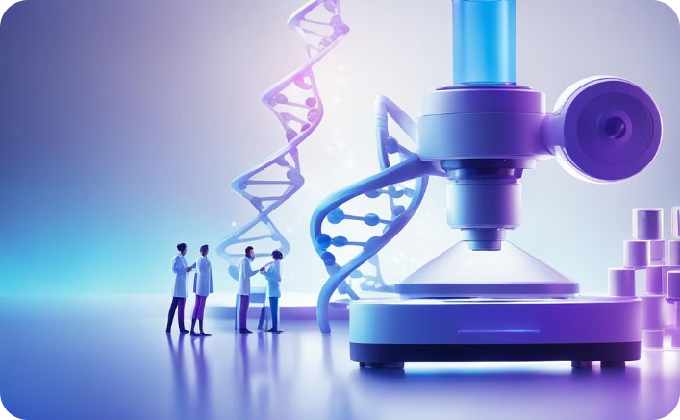
Applications of Gene Prediction in Biological Research
Drug Discovery
Genetic Analysis
Gene prediction contributes to identifying potential drug targets, aiding in the development of new medicines.
It enables researchers to conduct in-depth genetic analyses, leading to valuable insights in biological research.

Slide 7



Future developments in gene prediction
Advanced Machine Learning
1
Enhanced deep learning models for accurate predictions
Integration of Multi-Omics Data
2
Utilizing genomic, transcriptomic, and proteomic data
Precision Genome Editing Tools
3
Advancements in CRISPR and gene editing technologies

Slide 8
Case studies of successful gene prediction
Improved Disease Diagnosis
Biofuel Development
Accurate gene prediction led to early detection and personalized treatment for genetic disorders.
Identified genes contributed to the engineering of more efficient biofuel producing organisms.
Drug Discovery
Agricultural Advancements
Predicted genes enabled the discovery of new drug targets and therapeutic agents.
Understanding gene function improved crop traits and resistance to pests and diseases.

Slide 9



Ethical Considerations in Gene Prediction
Ethical Implications
Privacy Concerns
Biotech Regulation
Consider the impact of genetic testing on individuals and their families.
Address the potential misuse of genetic information and confidentiality.
Examine the need for clear guidelines to govern gene prediction and manipulation.

Slide 10
Conclusion and key takeaways
Gene prediction is a crucial aspect of bioinformatics, aiding in understanding genetic mechanisms and disease pathways. Accurate prediction methods can significantly impact drug development and personalized medicine. However, the field is challenged by the complexity of gene regulation and limited experimental validation. Ethical considerations surrounding privacy and genetic discrimination further complicate this area of research.

